Slide 1
CAUSE OF DEATH

Slide 2
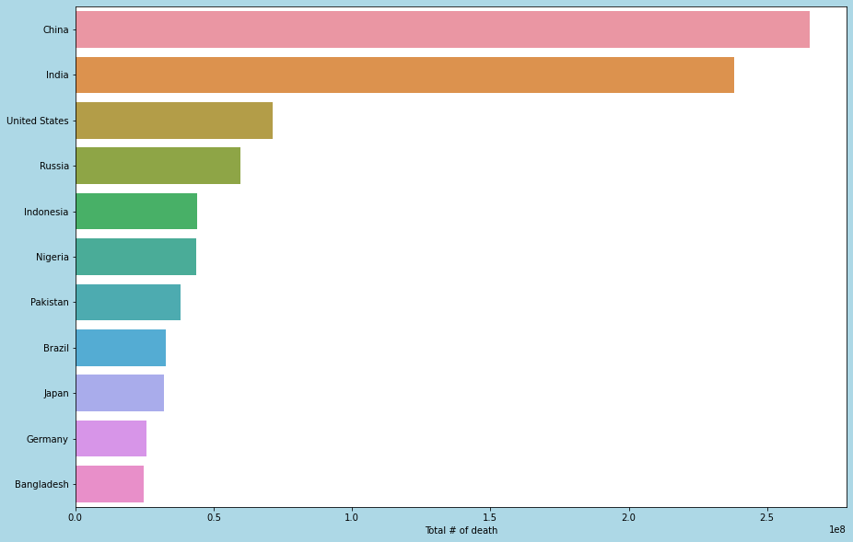
Top 10 countries having high death count

Slide 3
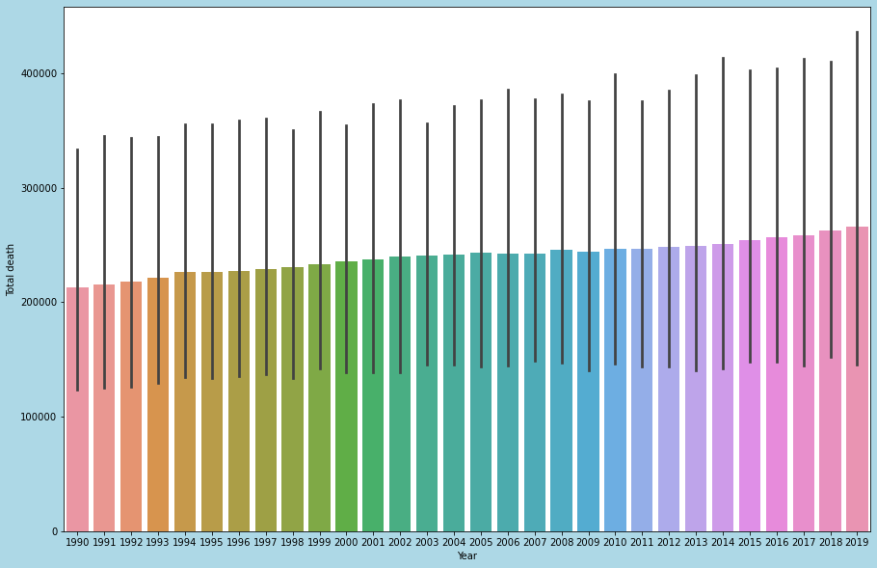
Year-wise death count
Recent year had high death. 2019 is high so we consider for 2019 and for top 5 countries

Slide 4
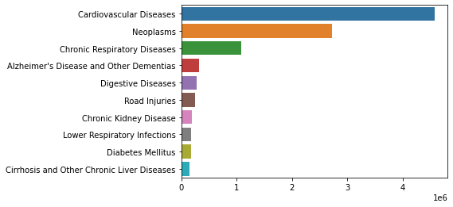
Top 10 reason for death: China

Slide 5
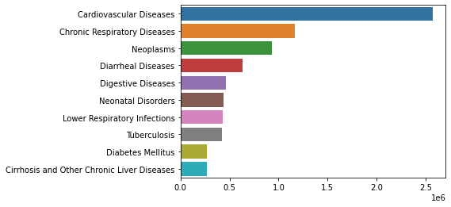
Top 10 reason for death: India

Slide 6
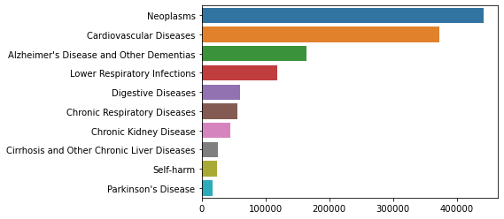
Top 10 reason for death: United Stated

Slide 7
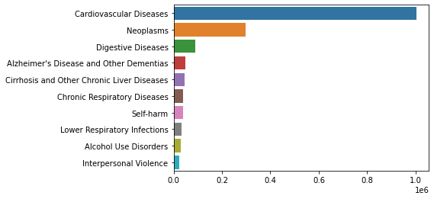
Top 10 reason for death: Russia

Slide 8
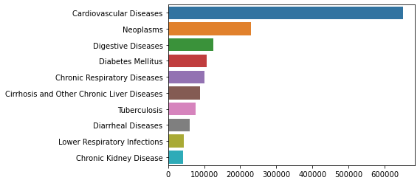
Top 10 reason for death: Indonesia

Slide 9
Conclusion:
1. From the above analysis, country having high population will have high death rate when compared with
Global other markets.
2. Most of the countries have high death reason as
CARDIOVASCULAR DISEASES and
NEOPLASM.
3. Other common reason which have high reason for death are
CHRONIC RESPIRATORY DISEASE
DIABETIES MELLITUS
DIGESTIVE DISEASES
4. Other special reason for death exists on country level like HIV/AIDS for Nigeria is also need to be
considered. But this scenario is rare and for country specific only.

